Slide 1
Data Analysis In R to Assess Movie Ratings Consensus
Edwin Edem Dzobo

Slide 2
Purpose
Understanding interactions with media
What media suggests about people’s tastes

Slide 3
Data
http://files.grouplens.org/datasets/movielens/ml-20m-README.html (GroupLens, Uni. Minnesota)
Movies.csv (compiled between May 1995 and March 2015)
Ratings.csv
Tags.csv
Links.csv
Focus: Movies and Ratings

Slide 4
Questions
Can movie ratings be used in determining viewer tastes?
Is it possible for viewers to be grouped based on the movies they watch?

Slide 5
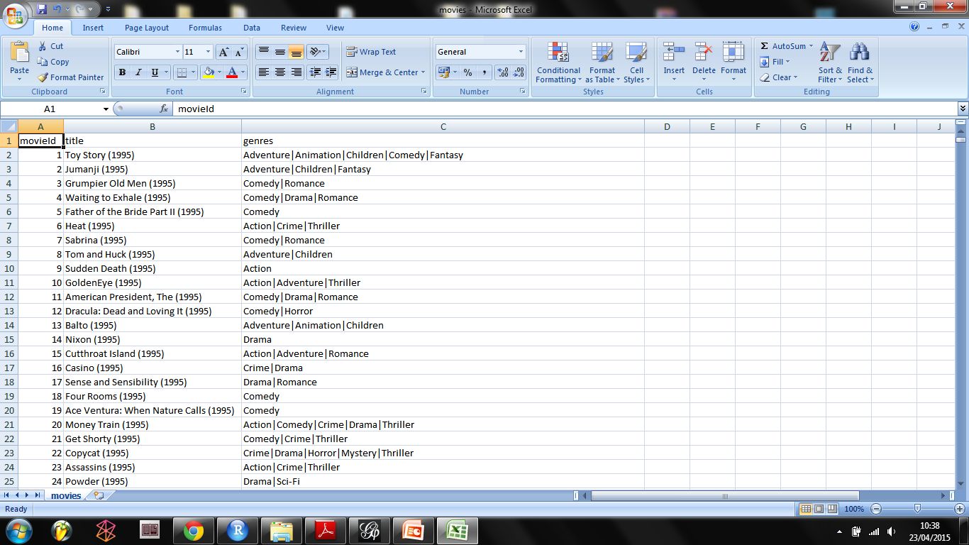
Movies.csv

Slide 6
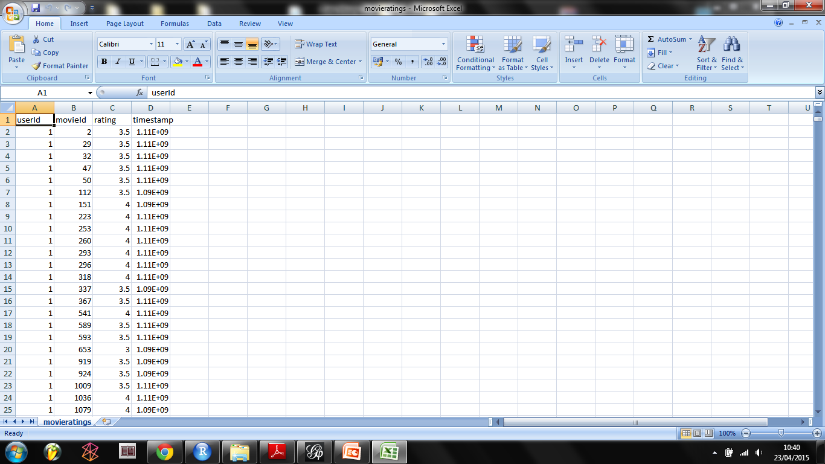
Ratings.csv

Slide 7
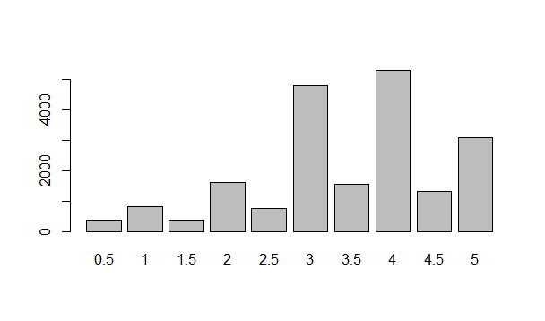
Analysis

Slide 8
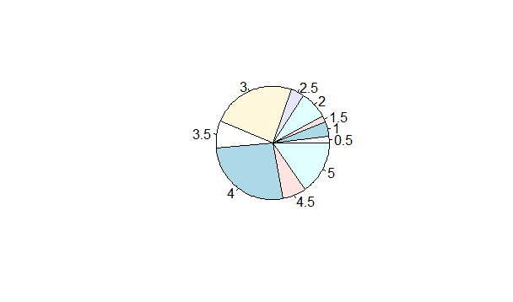
Analysis contd.

Slide 9
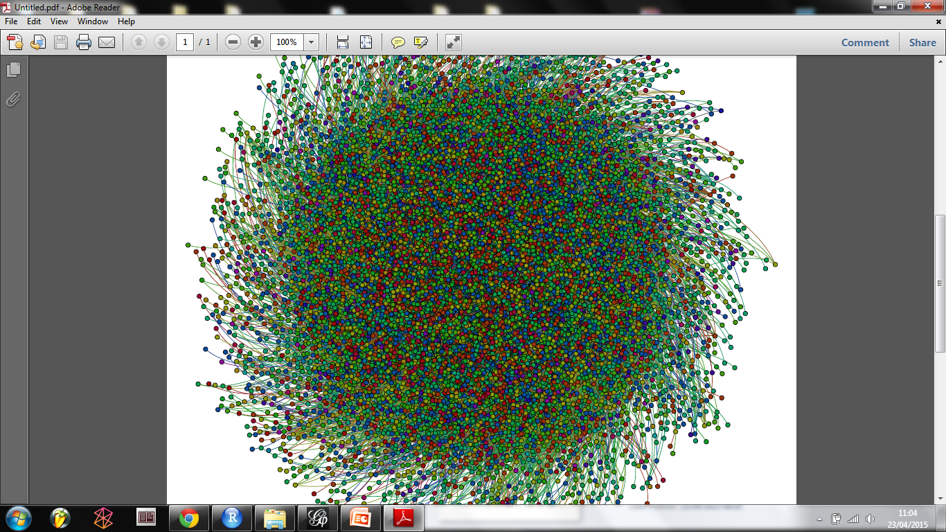
Analysis

Slide 10
Lessons
Big data can get too BIG.

Slide 11
Thanks!

